Slide 1
Keynote Address – 12 September 2018
Paul V. Sheridan
DDM Consulting
Dearborn, Michigan USA

Slide 2
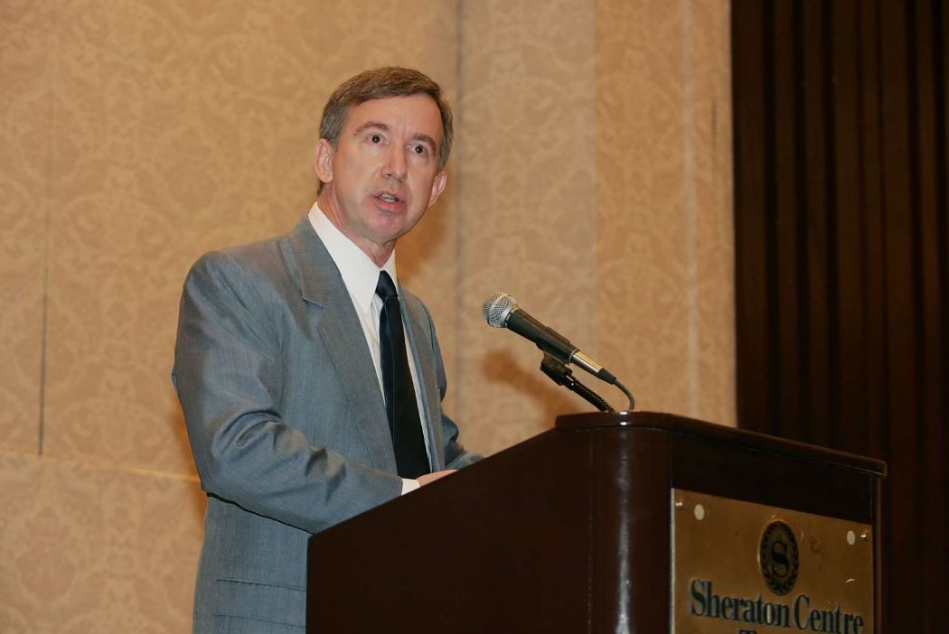
Paul V. Sheridan
DDM Consulting
Dearborn, Michigan USA
After a career with OEMs, Paul Sheridan specializes in transportation safety and efficiency. While at Chrysler Corporation, Sheridan led the original prototype development of the world renowned Dodge-Cummins Diesel Pickup truck, and later designed and managed the engineering programs for that award-winning product. One of only three recipients of the Lee Iacocca Chairman’s Award, Sheridan is also the only person in history to win the Civil Justice Foundation National Champion’s Award for work in transportation safety. With testimony that ranges from the local/federal courts, the United States Senate, to the highest court, the United States Supreme Court, Sheridan has been credited with numerous technological and regulatory advancements in safety under his adage:
“First and foremost, safety is a management issue.”
With degrees in physics, mathematics, and computer science (BS), and a Master’s in Business (MBA) from Cornell University, Sheridan concentrates on the safety and efficiency of electric mobility. Environmental protections offered by EVs will demand and drive energy sources that demonstrate true sustainability.
Proposal: Formerly a nuclear reactor operator, a long-term perspective is proposed which recognizes the incremental electrical energy requirements of the EV paradigm. To maximize the benefits of EVs, deployment of modern grid technologies, fortified by the reliability and predictability of third and fourth generation nuclear power plants, will be required . . .
Paul Sheridan is the only person to win the Civil Justice Foundation National Champion’s Award for work in transportation safety; now concentrates on the safety and efficiency of electric mobility.

Slide 3
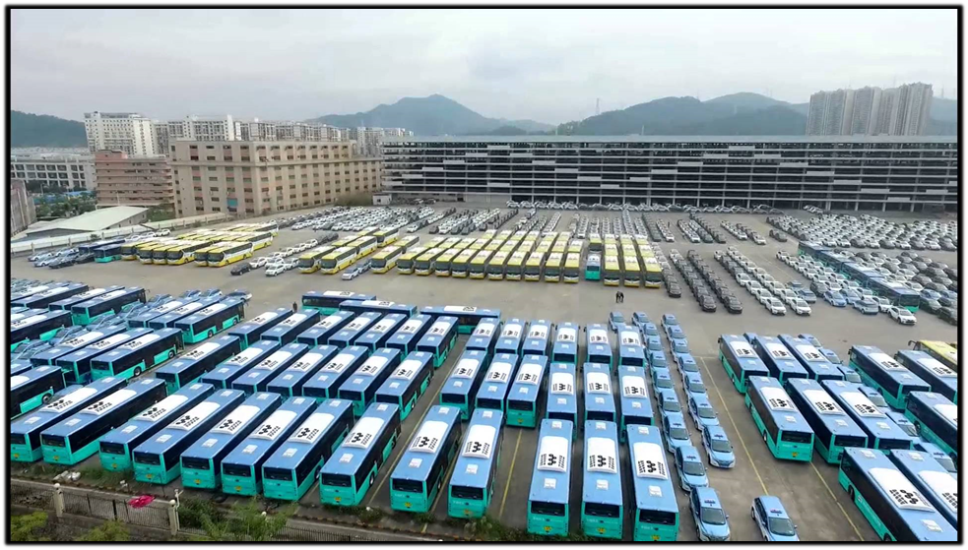
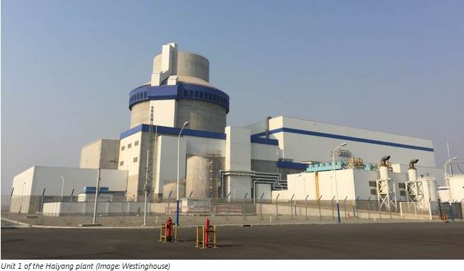
The Electric Vehicle Paradigm:
EVs as a Driver of Grid Modernization and Sustainable Nuclear Power
Keynote Address – 12 September 2018

Slide 4
The Electric Vehicle Paradigm:
EVs as a Driver of
Grid Modernization and Sustainable Nuclear Power
Three-Fold Context – Basis of Proposal
Proposals that involve (or allege to involve) protection of the environment must ensure that goal comprehensively. The natural beauty and ecology of a region must not to be diminished, or subjugated to the compromises of alleged “sustainability.”
B. The attitudes and lack of a long-term foresight in many public officials, regarding energy plans, specifically as such relates to the incremental electrical power demanded by a long-term vision of electric mobility, must be addressed/corrected.
It has already been determined that transport bus conversion to full EV constitutes the greatest and quickest of comprehensive benefits;
the proverbial ‘low hanging fruit.’

Slide 5
Do Wind Farms and/or Solar Farms
Fulfill ‘True Sustainability and True Environmental Protection’ ?
Question posed to the California Energy Commission (CEC) :
“ It has just been announced that the last of California’s nuclear power plants, Diablo Canyon, will be shut down. That means that the only nuclear power available to California will be imported from sites such as Palo Verde. What is the CEC plan to replace that power given its concerns about the incremental power needed for electric mobility? ”
Answer: “ Well . . . I’m not the nuclear guy. ”

Slide 6

Do Wind Farms and/or Solar Farms
Fulfill ‘True Sustainability and True Environmental Protection’ ?

Slide 7
Do Wind Farms and/or Solar Farms
Fulfill ‘True Sustainability and True Environmental Protection’ ?

Slide 8

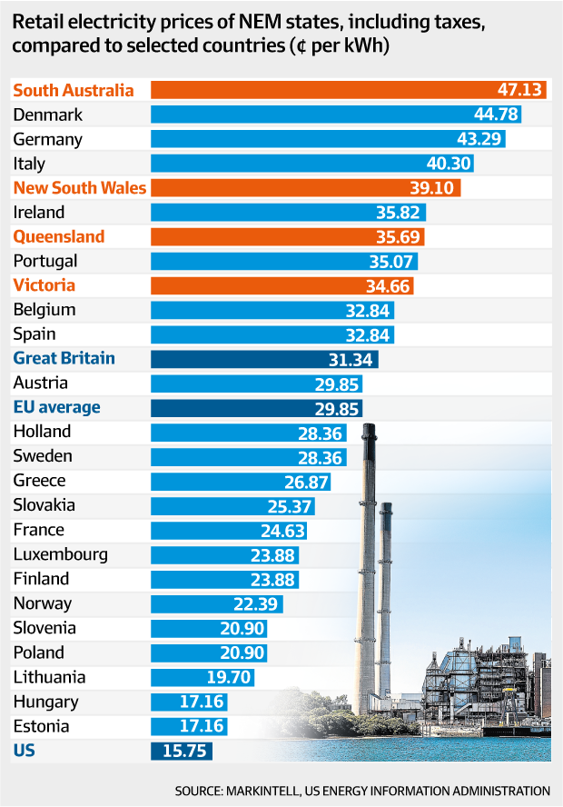

Slide 9
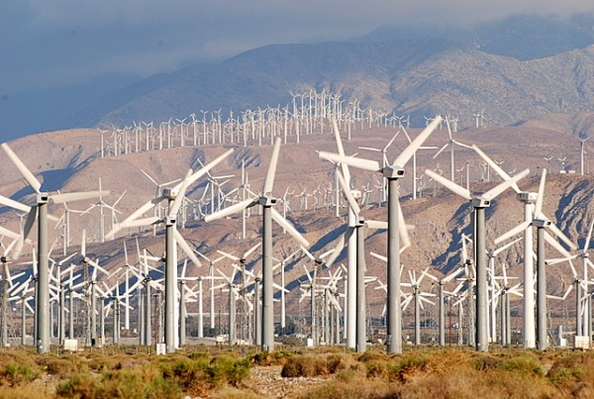
Do Wind Farms and/or Solar Farms
Fulfill ‘True Sustainability and True Environmental Protection’ ?
The “Footprint” Issue

Slide 10
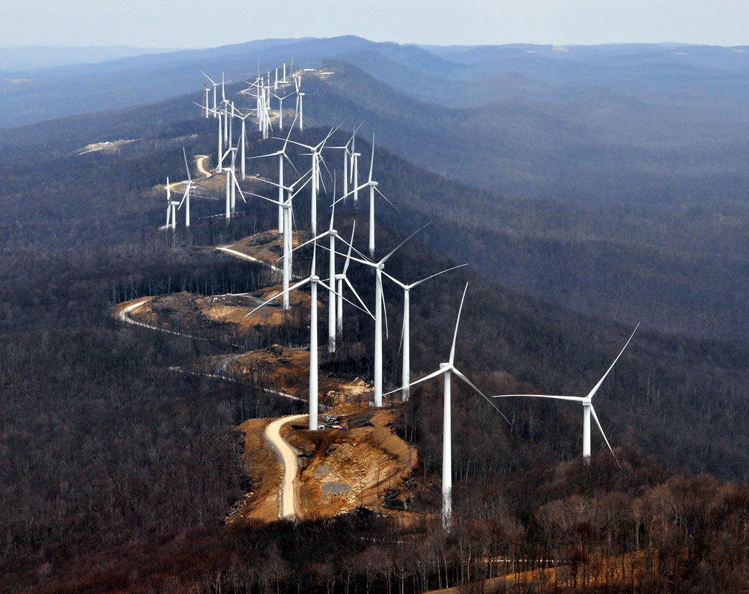
Do Wind Farms and/or Solar Farms
Fulfill ‘True Sustainability and True Environmental Protection’ ?
The “Footprint” Issue

Slide 11

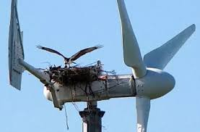
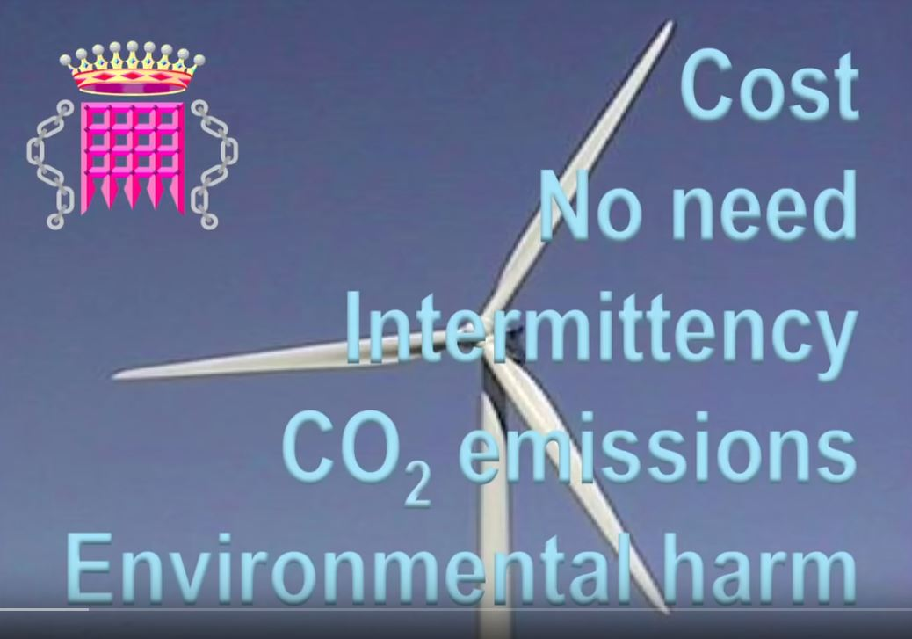
https://www.youtube.com/watch?v=ZH4m-Cs-u3Y

Slide 12
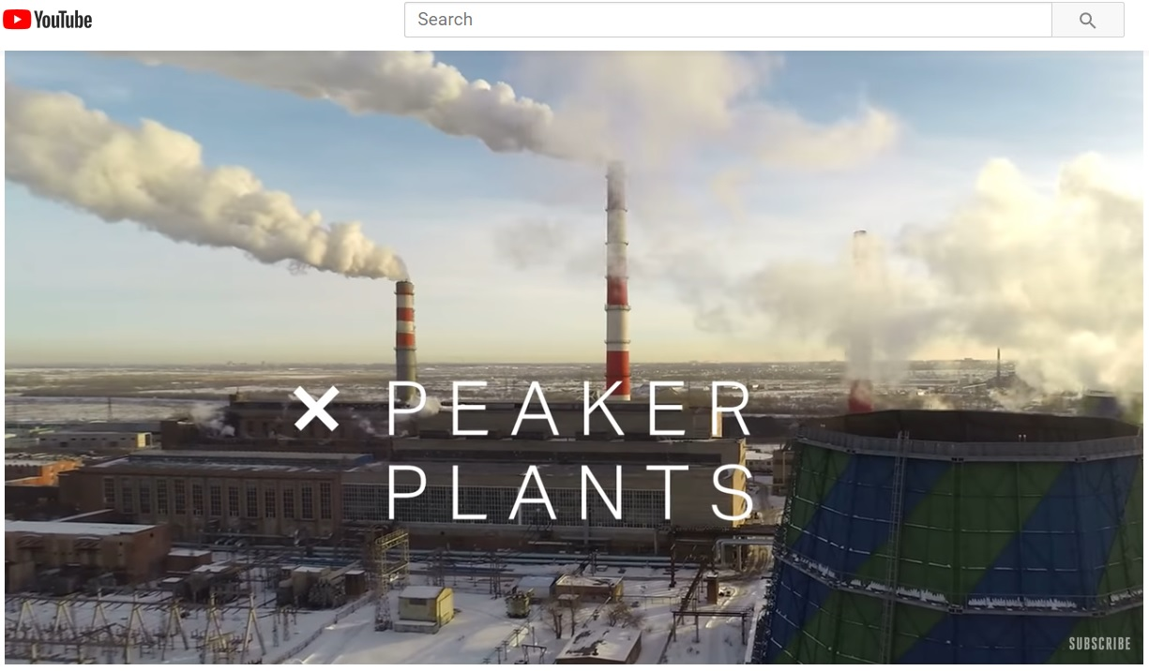
Do Wind Farms and/or Solar Farms
Fulfill ‘True Sustainability and True Environmental Protection’ ?
The “City Sized Battery” Proposal

Slide 13
Do Wind Farms and/or Solar Farms
Fulfill ‘True Sustainability and True Environmental Protection’ ?
The “City-Sized Battery” Proposal
“So, traditional plants aren’t super efficient. But they’re consistent and therefore predictable.
Renewable energy can be another story. Solar and wind power is cheap and clean and plentiful.
But only when the sun is shining or the wind is blowing.
So inconsistency is the big worry. That, you know, it’ll be a cloudy day, or it will be a still day, and all of a sudden your appliances won’t work. And that’s something that no one really wants.”
https://www.youtube.com/watch?v=8ge3ah1G8ok

Slide 14
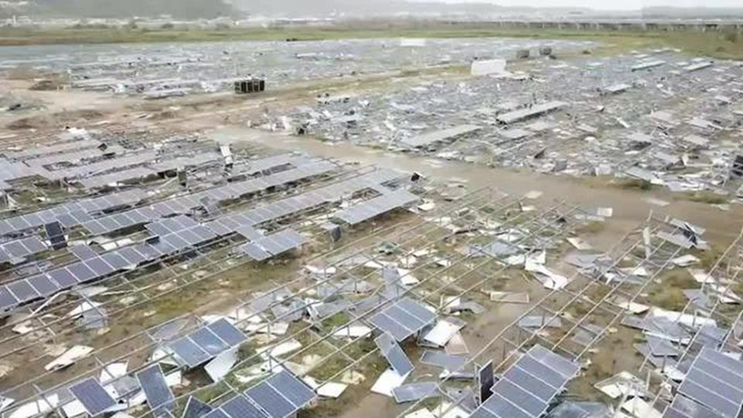
Do Wind Farms and/or Solar Farms
Fulfill ‘True Sustainability and True Environmental Protection’ ?
The “City-Sized Battery” Proposal
Pictured above is the environmental/poisonous disaster facing Puerto Rico after the winds from Hurricane Maria in 2017 spent less than 30 minutes merely in the vicinity of the Humacao solar farm.

Slide 15
Do Wind Farms and/or Solar Farms
Fulfill ‘True Sustainability and True Environmental Protection’ ?
The “City-Sized Battery” Proposal
Reacting to this obvious fate of solar farms in ‘severe weather zones,’ Michael Shellenberger, a former advocate of ‘renewable energy,’ asks:
“If Solar Panels are so clean why do they produce so much toxic waste?”
https://www.forbes.com/sites/michaelshellenberger/2018/05/23/if-solar-panels-are-so-clean-why-do-they-produce-so-much-toxic-waste/#66c7816c121c
https://www.nationalreview.com/2017/06/solar-panel-waste-environmental-threat-clean-energy/

Slide 16
Do Wind Farms and/or Solar Farms
Fulfill ‘True Sustainability and True Environmental Protection’
Versus Hurricanes and versus the Nuclear Option ?
September 1, 2017 Forbes Magazine headline reads:
Hurricane Harvey Makes the Case for Nuclear Power
Hurricane Harvey made land fall in Texas this week and the flooding was historic. What is shaping up to be the most costly natural disaster in American history, the storm has left refineries shut down, interrupted wind and solar generation, caused a constant worry about gas explosions, and caused a chain of events that led to explosions and fires at the Arkema chemical plant that is only the beginning. Over a fifth of the country’s oil production has been shuttered. Natural gas futures hit a 2-year high as did gasoline prices at the pump.
But the Texas nuclear power plants have been running smoothly. (bolding added)
The two nuclear reactors at the South Texas Project plant near Houston were operating at full capacity despite wind gusts that peaked at 130 mph as the Hurricane made landfall. The plant implemented its severe weather protocols as planned and completed hurricane preparations ahead of Category 4 Hurricane Harvey striking the Texas Gulf Coast on August 25th. Anyone who knows anything about nuclear was not surprised. Nuclear is the only energy source immune to all extreme weather events – by design.
This nuclear plant has steel-reinforced concrete containment with 4-foot (1.2 meter) thick walls. The buildings housing the two reactors, vital equipment and used fuel have steel-reinforced concrete walls up to 7 feet (2.1 meters) thick, which are built to withstand any category hurricane or tornado. It can even withstand a plane flying directly into it.
https://www.forbes.com/sites/jamesconca/2017/09/01/hurricane-harvey-makes-the-case-for-nuclear-power/#317896993625

Slide 17
Do Wind Farms and/or Solar Farms
Fulfill ‘True Sustainability and True Environmental Protection’ ?
The V2X “solution”

Slide 18
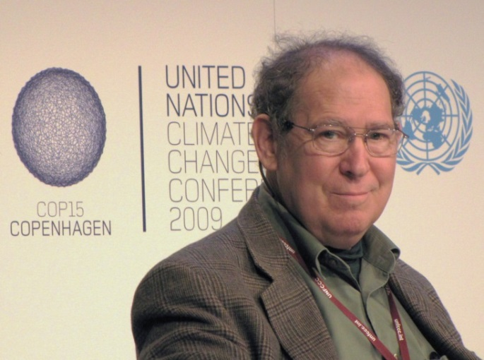
The Electric Vehicle Paradigm:
EVs as a Driver of Grid Modernization and Sustainable Nuclear Power
Earlier energy studies failed because these were untimely; many failed to anticipate the rapid technical advances in EV product and its widespread availability;
these studies neglected the incremental electrical energy needs of the EV paradigm.
Too often these studies were characterized-by and contextualized-by
the so-called “Climate Crisis,” which is typified by the following rhetoric:
“ On the one hand, as scientists we are ethically bound to the scientific method . . . On the other hand, we are not just scientists but human beings as well . . . (‘ double ethical bind ’)
To do that we need to get some broad based support, to capture the public’s imagination. That, of course, means getting loads of media coverage. So we have to offer up scary scenarios, make simplified, dramatic statements, and make little mention of any doubts we might have.
Each of us has to decide what the right balance is between being effective and being honest. I hope that means being both.”
“Father of Anthropogenic Global Warming” (AGW),
Stanford University Professor Stephen Schneider

Slide 19
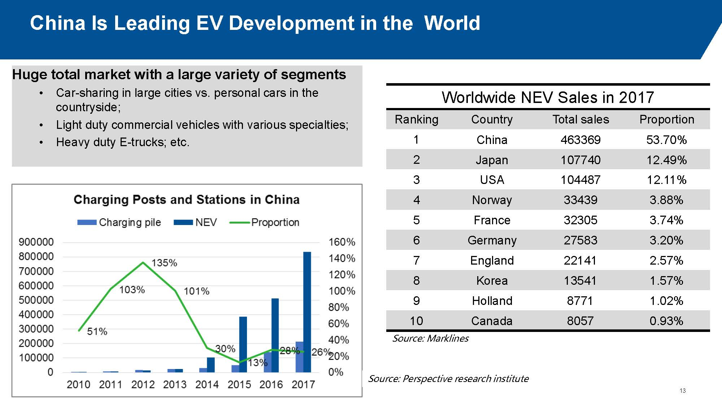
Very Brief Review of World Leader in Electric Mobility : China
Memo: Slide courtesy of Mr. Xingyi Xu of Shanghai Dajun Technologies.
“ Electrification is a done deal as several countries have announced a deadline for the sale of internal combustion engine cars to end. Electric vehicles are on the cusp of another boom.” BYD Chairman Wang Chuanfu

Slide 20
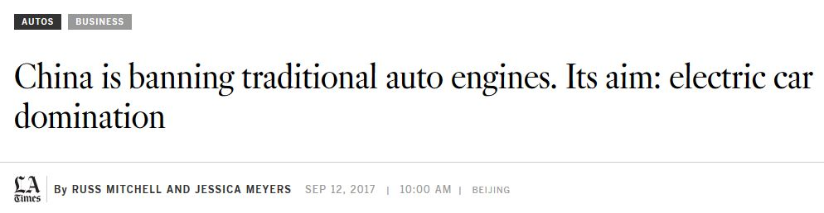
Very Brief Review of World Leader in Electric Mobility : China
Does China intend to charge the batteries of its EV fleet by use of
wind farms and/or solar farms ?
If China does ban the internal combustion engine (ICE) by 2030, what is the long-term solution to the enormous incremental electrical energy required to accommodate their new fleet of electric vehicles ?
Would it not be prudent to study the China approach, wherein capital
that was previously squandered in “carbon sequestration” retrofits of coal-fired plants, is now deployed to the construction of modern highly reliable and truly sustainable nuclear power ?

Slide 21
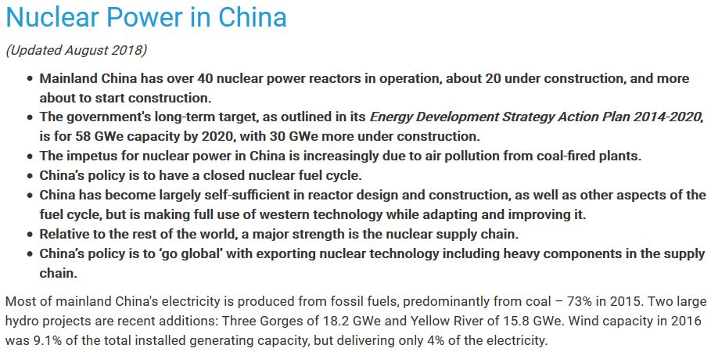
Very Brief Review of World Leader in Electric Mobility : China
China’s commitment to modern sustainable nuclear power, and its commitment to EVs
are inextricably connected.
The former allows the latter to be not merely feasible, but robust: These connected commitments resolve the pollution issues at both ends of the “well-to-wheel” life cycle.

Slide 22
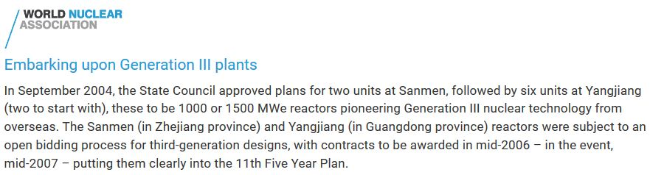
Very Brief Review of World Leader in Electric Mobility : China

Slide 23
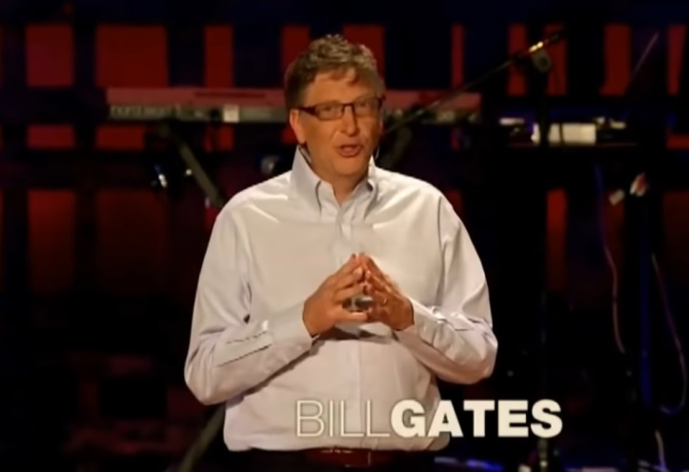
Advanced Nuclear Energy Concepts and the Nuclear Waste Issue:
TerraPower and the Traveling Wave Reactor (TWR)
Global depleted uranium (“waste”) is a feedstock for the TerraPower TWR. The USA alone has stored (under EO-12192) over 772,000 tons.
TerraPower estimates that the Paducah stockpile alone represents an energy resource equivalent to $100 trillion worth of electricity.
TerraPower estimates that TWR would enable stockpiles of nuclear “waste” to sustain over 80% of the global population at US levels of per capita energy usage . . . for a thousand years . . . without emitting any airborne pollutants.
http://pvsheridan.com/Sheridan2TCAT-1.pdf (Please see Attachment 9)

Slide 24
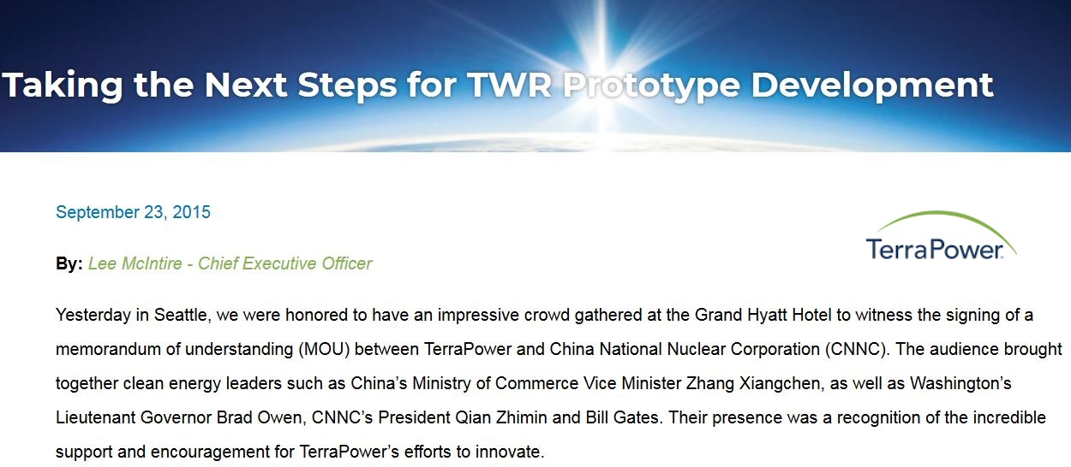
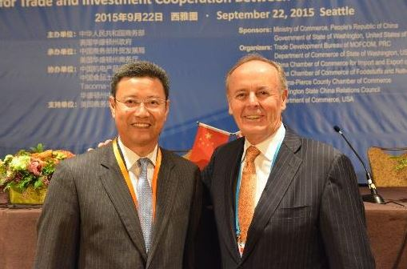
Advanced Nuclear Energy Concepts and the Nuclear Waste Issue:
TerraPower and the Traveling Wave Reactor (TWR)
CNNC President Qian Zhimin (L) and TerraPower CEO Lee McIntire (R) at the MOU ceremony.
https://www.youtube.com/watch?v=eDCEjWNGv6Y

Slide 25
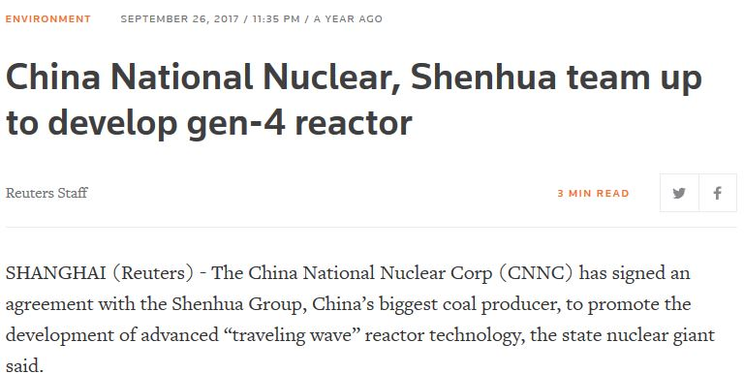
Advanced Nuclear Energy Concepts and the Nuclear Waste Issue:
TerraPower and the Traveling Wave Reactor (TWR)
“China by a very large margin is the largest market in the world for new power plants of any type. If we do not get our act together, the low-carbon energy business will be owned by the Chinese.”
Professor Charles Forsberg at the Massachusetts Institute of Technology (MIT)

Slide 26
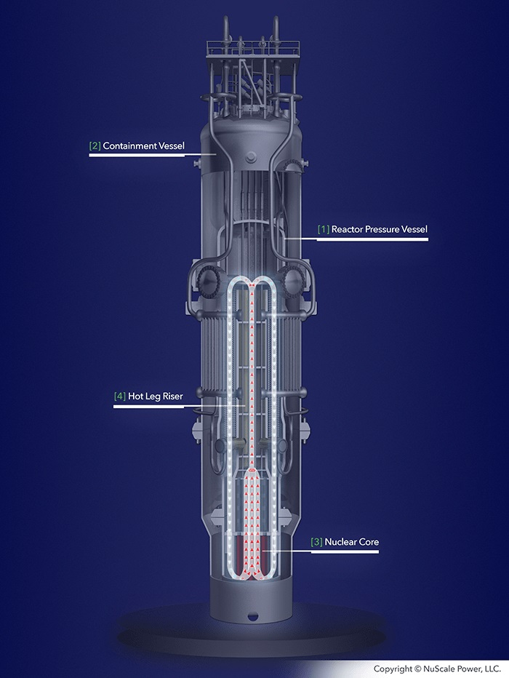
Small Modular Reactor (SMR) : The Right ‘Time & Place’ in Energy History
The convergence of modern nuclear plant designs with the EV paradigm has greatly favored policy makers in China;
they are poised at the right
‘time & place’ in history.
But an emerging technology is equally poised, and represents another stunning example of American creativity : the Small Modular Reactor or SMR.
https://www.youtube.com/watch?v=eDCEjWNGv6Y

Slide 27
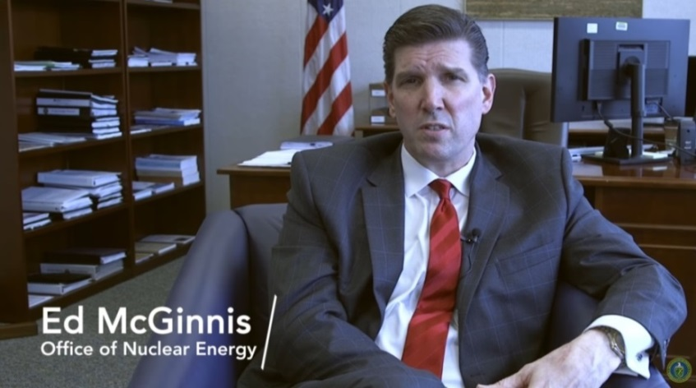
Small Modular Reactor (SMR) : The Right Time & Place in Energy History
NuScale Power’s SMR is First-Ever to Complete
Nuclear Regulatory Commission (NRC) Phase 1 Review
"As opposed to an $8 billion unit for a gigawatt or larger before financing, you’re looking at a unit that may cost $1 billion to $1.5 billion to put that base plant in, with $350 million to $450 million per unit to add to it, allowing a utility to take bites at a time. That could break down significant barriers to nuclear generation at smaller utilities, and in countries with limited finances or smaller grids that do not need large-scale reactors. I think the implication is potentially dramatically opening up a market, a market that would never have materialized with large reactors. As valuable as large reactors still are, we simply have utilities that don't have the financial wherewithal and also are very excited about the design attributes."
Assistant Secretary for the US Department of Energy (DOE), Office of Nuclear Energy
http://pvsheridan.com/Sheridan2TCAT-1.pdf (Please see Attachment 8)

Slide 28

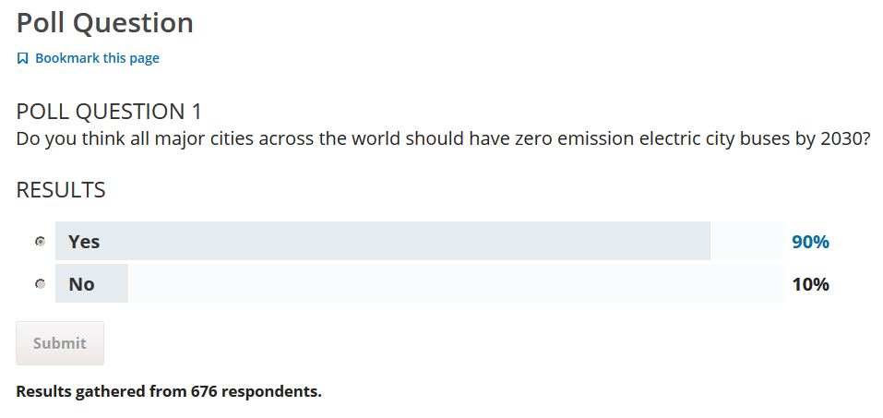
https://www.edx.org/professional-certificate/delftx-electric-cars

Slide 29
The Electric Vehicle Paradigm:
EVs as a Driver of Grid Modernization and Sustainable Nuclear Power
C O N C L U S I O N S – P A R T O N E
In the context of the rapidly emerging EV paradigm and its wonderful vehicle products, and the rapid ongoing advances in nuclear power:
• Conclusions regarding energy generation contextualized by the so-called “climate crisis” must be reviewed, recalculated, and many discarded.
○ Earlier energy studies failed because these were untimely; most never
considered the incremental electrical energy required by the EV paradigm.
The ‘Low Hanging Fruit’ in terms of comprehensive benefits, and in terms of EVs as a ‘Driver of Grid Modernization and Sustainable Nuclear Power’ are
the three main bus fleets:
Municipalities
Grade Schools
Universities

Slide 30
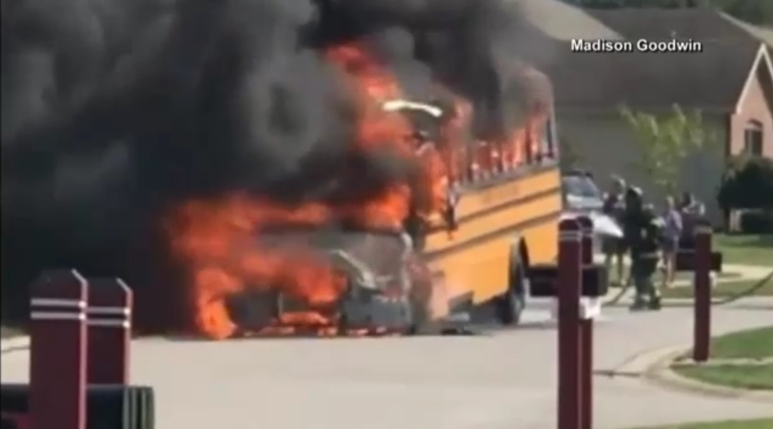
The Electric Vehicle Paradigm:
EVs as a Driver of Grid Modernization and Sustainable Nuclear Power
C O N C L U S I O N S – P A R T T W O
https://www.youtube.com/watch?v=tP06nZHS7KM
https://www.youtube.com/watch?v=MV43yUWI4yM
First and Foremost, Safety is a Management Issue
Paul V. Sheridan - DDM Consulting

Slide 31

The Electric Vehicle Paradigm:
EVs as a Driver of Grid Modernization and Sustainable Nuclear Power
Keynote Address – 12 September 2018
http://pvsheridan.com/Sheridan2Shanghai-1-12September2018.pptx
http://pvsheridan.com/Sheridan2Shanghai-1-12September2018.pdf
End of Document

